Slide 1
Illumination and Surface Rendering
Dr. Narendra Kohli
HBTU, Kanpur

Slide 2
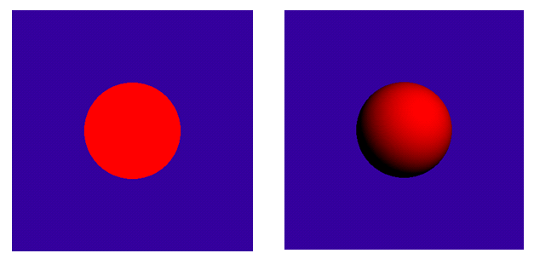
Why Lighting?
3D without lighting
3D with lighting

Slide 3
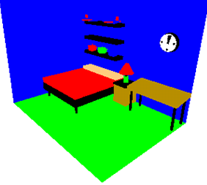
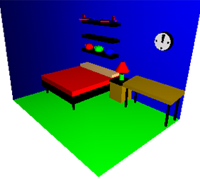
3D without lighting
3D with lighting

Slide 4
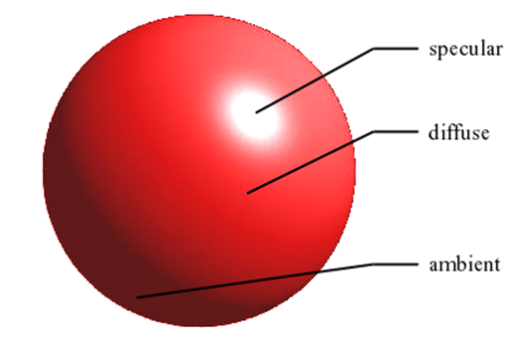
Components of Reflections
Ambient – surface exposed to indirect light reflected from nearby objects.
Diffuse – reflection from incident light with equal intensity in all directions. Depends on surface properties.
Specular – near total of the incident light around reflection angle.

Slide 5
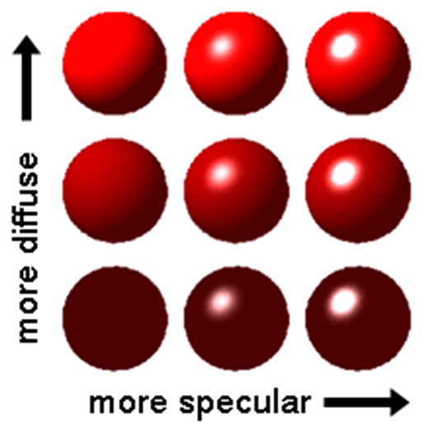

Slide 6

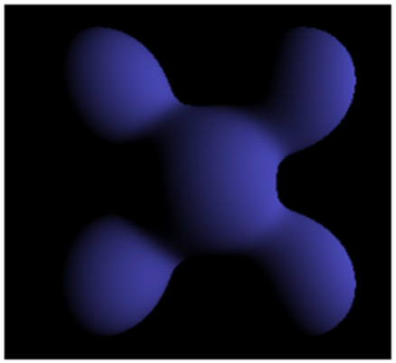
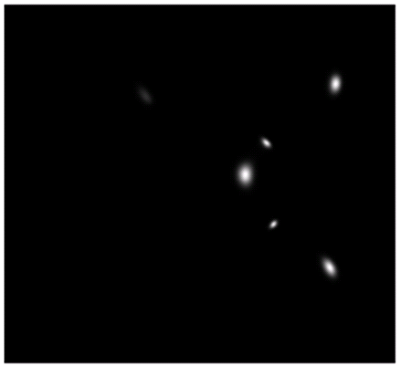
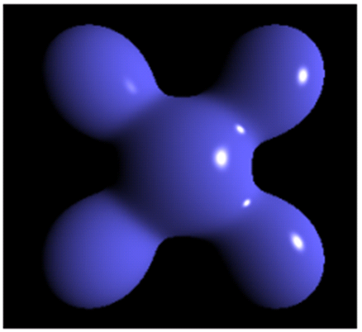
ambient
diffuse
specular
final

Slide 7

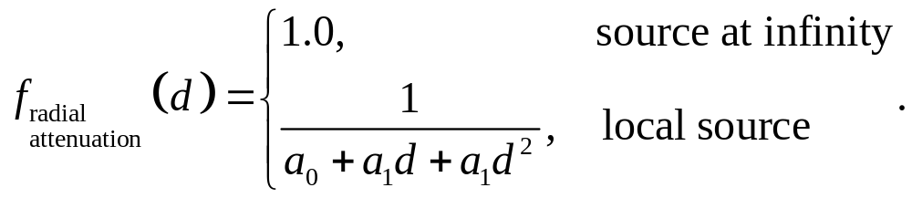
Light Sources
This is a problem in practice. 1/d² produces too much intensity variations for objects very close to source. Realistic sources are not infinitesimal small. The remedy is in adding a linear term.
Another problem occurs when the source is at infinity. Light rays are nearly parallel but intensity decays quadratic and we still wish to display the object

Slide 8


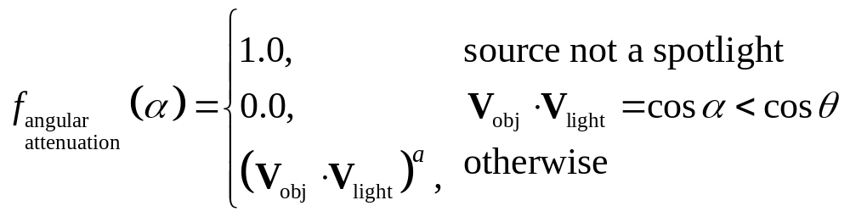
Directional Source (Spotlight)
To object vertex
Light source
Cone axis vector
Points outside the cone are not illuminated (stay in dark). Angular attenuation is:

Slide 9
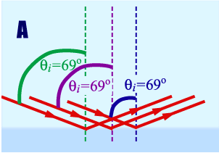
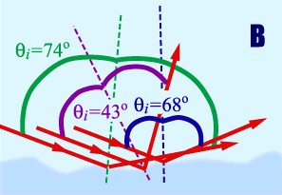
Illumination Models
Surface lightening models compute the outcome of the interactions between incident radiant energy and the material composition of the object.
When the surface is smooth reflections are similar at all point. This is called total reflection.
If the surface is rough reflected light is scattered in all directions. This is called diffuse reflection.

Slide 10
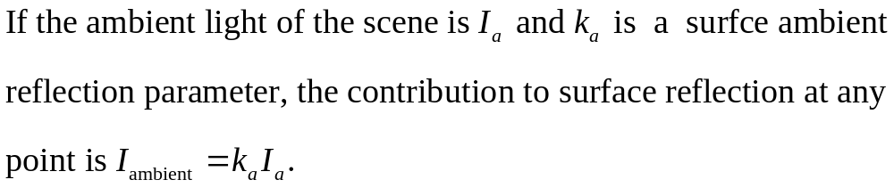
A basic illumination is obtained by an ambient light which determines the brightness of the scene. It is uniform for all objects, independent of the viewing point and direction. The amount of the reflected light (diffuse reflection) depends however on the surface optical properties.
Ambient light alone is not enough to render a scene and light sources are added.

Slide 11
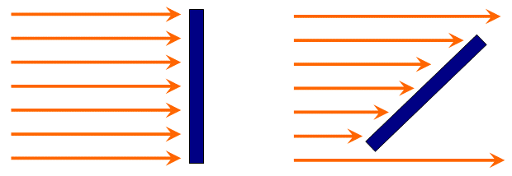



The amount of incident light depends on the orientation of the surface relative to the light source direction.
Incident light

Slide 12
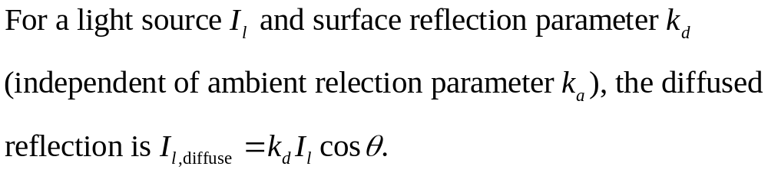
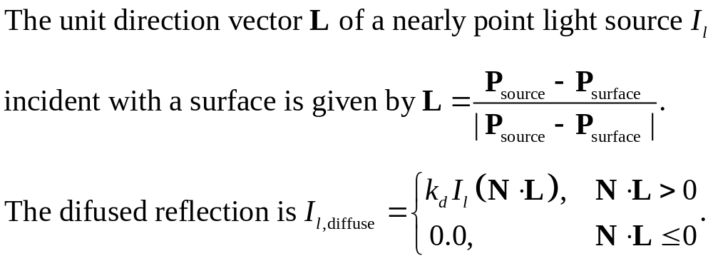

Slide 13
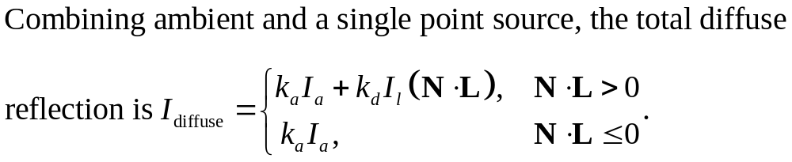
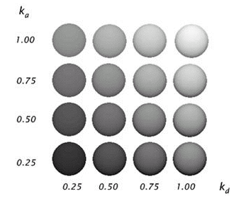
more ambient
more diffuse

Slide 14







Specular Reflection and the Phong Model
The bright spot (specular reflection) sown on shiny surfaces is the outcome of total reflection of the incident light in a concentrated region around the specular-reflection angle.
A shiny surface has a narrow specular reflection range.
A dull (rough) surface has a wide specular reflection range.

Slide 15

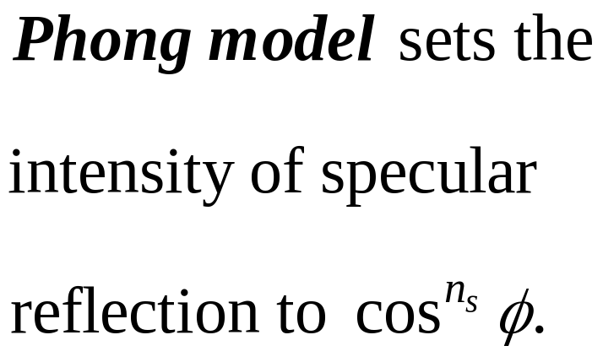





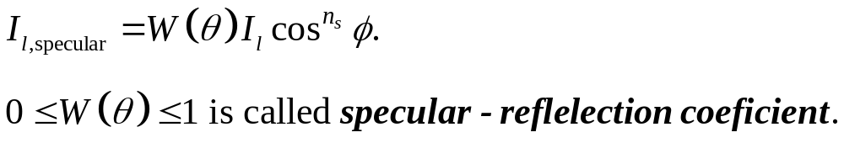

Slide 16
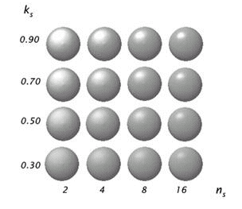
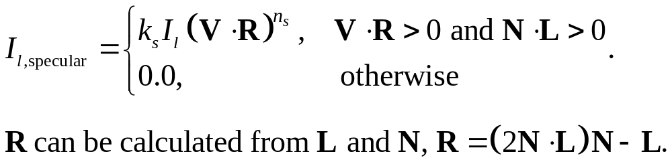
If light direction L and viewing direction V are on the same side of the normal N, or if L is behind the surface, specular effects do not exist.
For most opaque materials specular-reflection coefficient is nearly constant k_{s}.

Slide 17






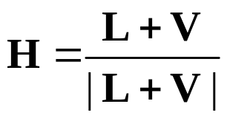
Efficient computations
The normal N may vary at each point. To avoid N computations, angle Φ is replaced by an angle α defined by a halfway vector H between L and V.
If the light source and the viewer are relatively far from the object α is constant.
H is the direction yielding maximum specular reflection in the viewing direction V if the surface normal N would coincide with H. If V is coplanar with R and L (and hence with N too) α= Φ/2.

Slide 18
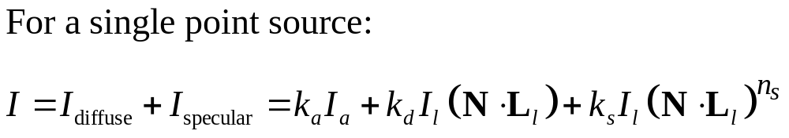
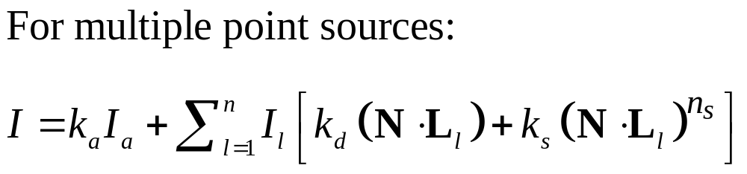
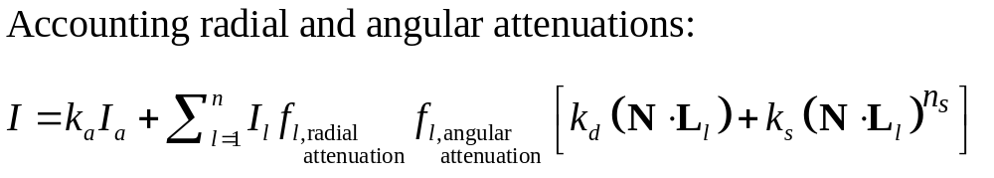
Combining Everything Together

Slide 19
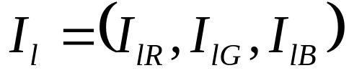
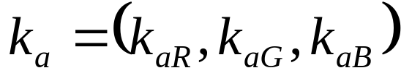
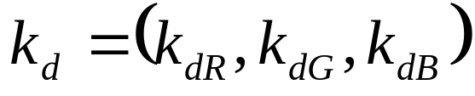
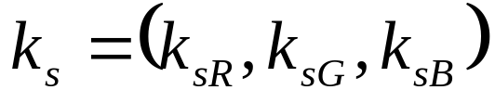
How Colors Get In?
Each light source has red, green and blue (RGB) components.
Similarly, the ambient, diffuse and specular coefficients of each surface has red, green and blue (RGB) components.
Each components of the color is then calculated separately. All final components are then combined to set the final color (RGB) of a point.

Slide 20
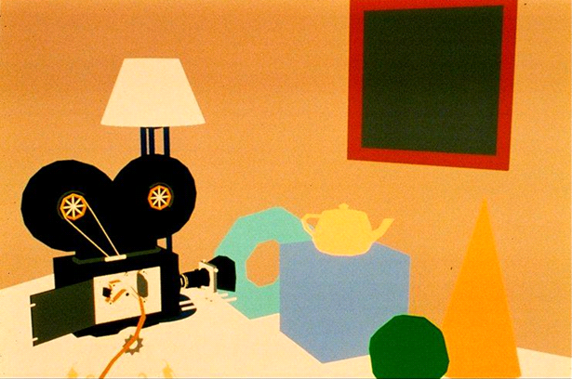
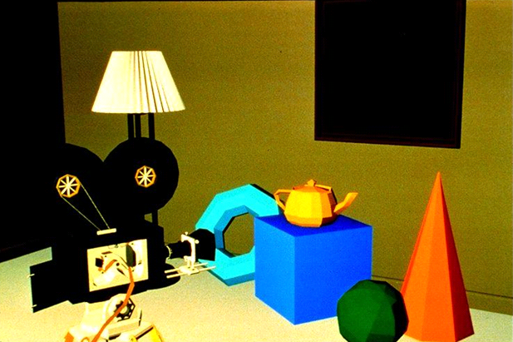
Rendering Reminder
3D drawing without rendering results 2D image.
3D drawing with rendering obtains depth and perspective impression.

Slide 21
Polygon Rendering Methods
Illumination model can be applied at every projected pixel. Very expensive.
Intensity can be calculated at few locations of the surface and then approximated at other locations
Usually only surface approximation by polygons and scan-line rendering are supported. Color intensities are calculated at vertices and then interpolated for the rest points.

Slide 22
The simplest is to use the color of polygon vertex or centroid for the rest points. This is called flat surface rendering.
Flat surface rendering provides accurate display if all the following assumptions are satisfied:
  Displayed object is polyhedron.
  All light sources are sufficiently far from object, so N∙L attenuation is constant over entire surface.
  Viewing position is sufficiently far so V∙R is constant over all surface.
Problem: abrupt color change across edges.

Slide 23
Gouraud Surface Rendering
Gouraud surface rendering, called also intensity-interpolation surface rendering, provides smooth color transitions across edges of polygon surfaces. It eliminates the intensity discontinuities occurring in flat rendering.
Determine the average unit vector at each polygon vertex.
Apply illumination model at each vertex to obtain color intensities at that position.
Linearly interpolate intensities over projected areas.

Slide 24
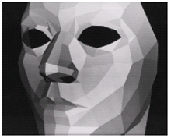
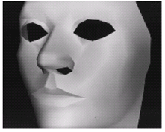
Flat rendering
Gouraud rendering

Slide 25
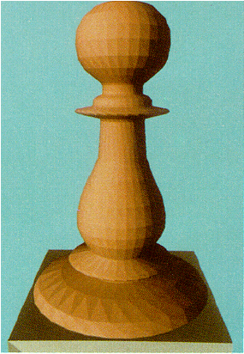
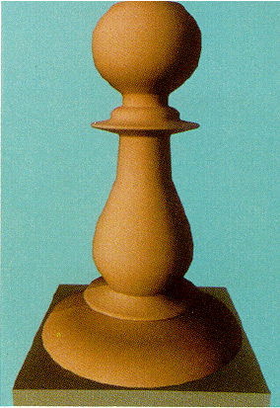
Flat rendering
Gouraud rendering

Slide 26
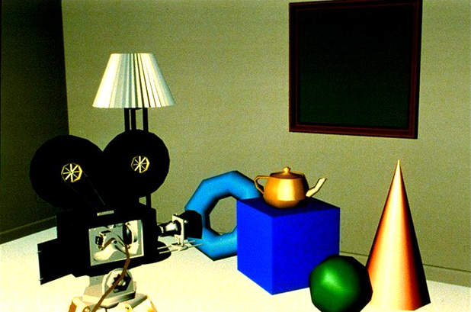
Flat rendering
Gouraud rendering

Slide 27





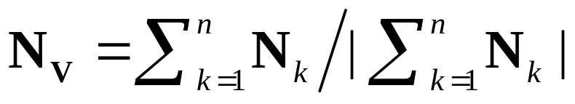
The normal vector at the vertex V is the average of the polygon normal vectors sharing that point.

Slide 28
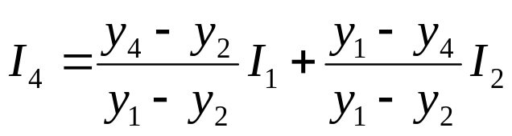
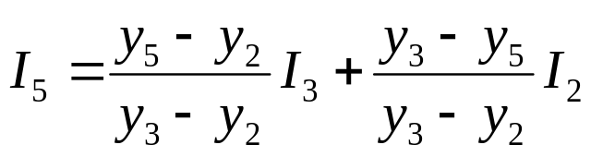
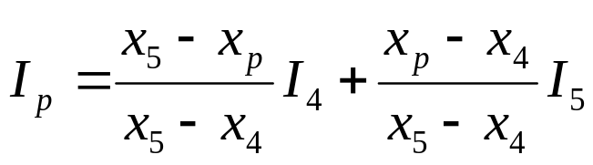
y
3
Ends of a scan-line are interpolated from vertices.
1
Scan-line
4
p
5
2
x
Internal point is interpolated from end points.
Avoid most divisions since progression of y is to y-1. and progression of x is to x+1. Same methods as used in basic drawing are applicable.

Slide 29
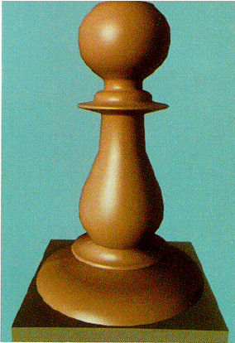
Phong Surface Rendering
Gouraud rendering may miss specular reflections and also create anomalies of bright or dark bands in image.
Gouraud rendering
Phong rendering

Slide 30



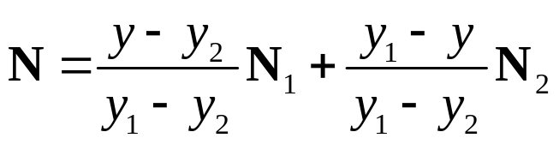

Instead of interpolating intensities, the average normal vectors at vertices are interpolated. Interpolation is done similarly as for intensities, taking advantage that y is progressing to y-1 and x to x+1.
Scan-line y
The computation penalty is that the illumination model is now computed for every point of surface.

Slide 31
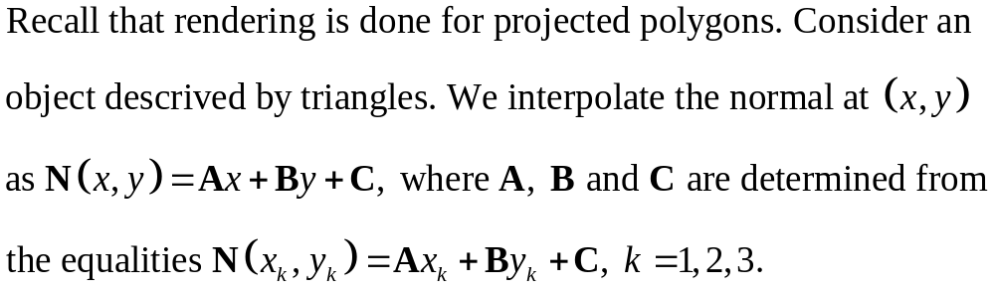
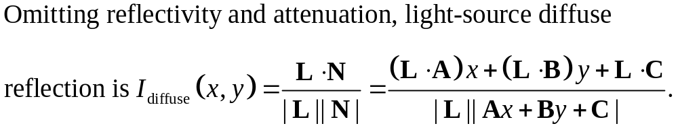
Fast Phong Surface Rendering
It significantly reduces the amount of computations at each point by approximating some of the illumination components (G. Bishop and D.M. Weimer, 1986).

Slide 32
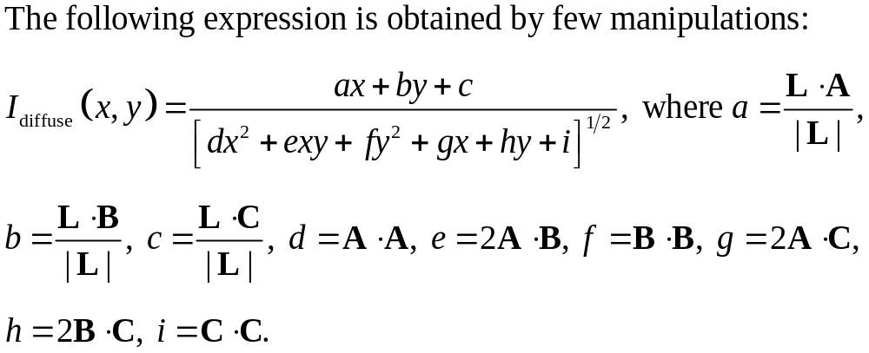
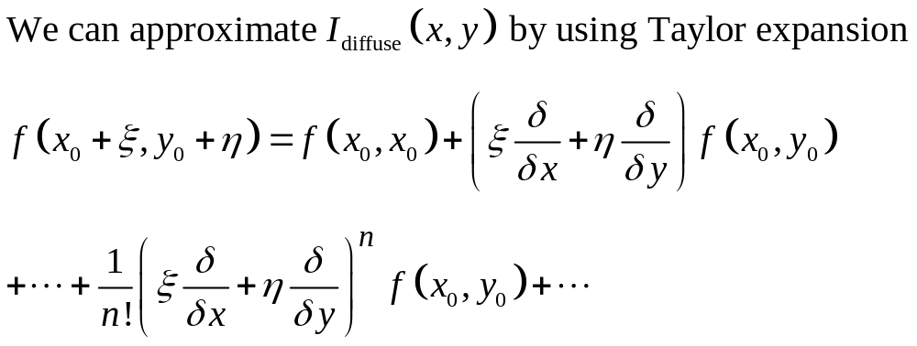

Slide 33
